Slide 1
Retirement of a Partner
Represented By
Abdul Hannan

Slide 2

Introduction
A Partner may retire from the frame for different reasons such as difference with the other partners better business opportunity, old age etc.

Slide 3
Effects of Retirement of a Partner
To terminate and a create a new Partner
Adjustment undrawn profit or accumulated losses
Revaluated and proper adjustment of assets and liabilities.
Combined shares of remaining partners will increased.

Slide 4
Adjustments for Retirement of a Partner
Change in the profit shearing ratio
Goodwill
Revolution of assets and Liabilities
Reverse and Surplus
Partners capital

Slide 5
Change in the Profit Shearing Ratio
New Profit Shearing Ratio
Gaining Ratio

Slide 6
New Profit Sharing Ratio
When a partner is retiring the share of retiring partner may be taken over by the remaining partners in their old ratio or other ratio
Due to this acquisition the profit sharing ratio between the remaining partners will changed
The profit shearing ratio between the continuing partners will remain same

Slide 7
Gaining Ratio
After retirement of partner the combine share of remining partner will be Increased
The ratio in which the remaining partners are acquiring the share of the retiring partner is called Gaining Ratio
Gaining Ratio = New Ratio – Old Ratio

Slide 8
Treatment of Goodwill
At the time of retirement of partner the retiring partner is entitled to his share in the goodwill of the firm.
For share of goodwill of retiring partner Journal will be
Continuing partners Capital accounts Dr……...........(Share of retiring partner)
To retiring partner Capital Account.

Slide 9
Revolution of Assets and Liabilities
Sl | Description(Journal) | Notes
1 | If the value of the assets increase | Assets Account Dr ( Changed Value) To revolution Account
2 | If the value of the assets decrease | Revolution Account Dr ( Changed Value) To Assets Account
3 | If the value of the Liabilities Increase | Revolution Account Dr ( Changed Value) To Liabilities Account
4 | If the value of the Liabilities decrease | Liabilities Account Dr ( Changed Value) To revolution Account
5 | For Profit on revolution | Revolution Account Dr To All Partner Capital Account
6 | For Loss on revolution | All Partner Capital Account Dr To Revolution Account

Slide 10
Reverse and Surplus
Sl | Description(Journal) | Notes
1 | For General Reverse , Profit & Loss and other Reserve | General Reserve Account Dr. Profit & Loss Account Dr. Other Reseve a Account Dr. To All partners Capital Account
2 | For Profit & Loss account Dr. Balance | All partners Capital Account Dr. To Profit & loss Account

Slide 11

Discussion on Practical Problem

Slide 12
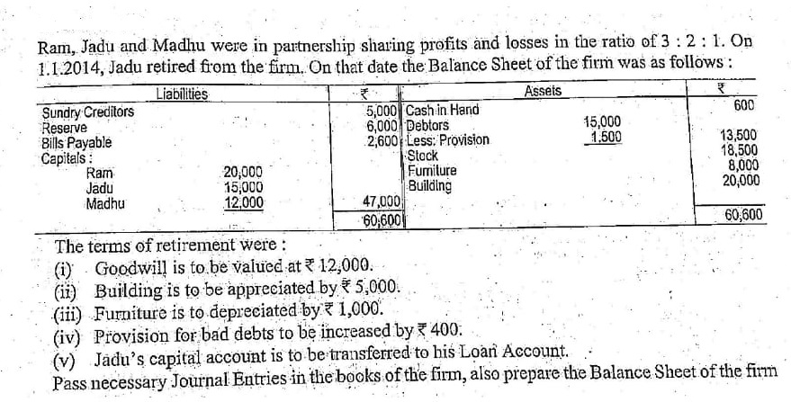
Problem on Retirement of a Partner

Slide 13
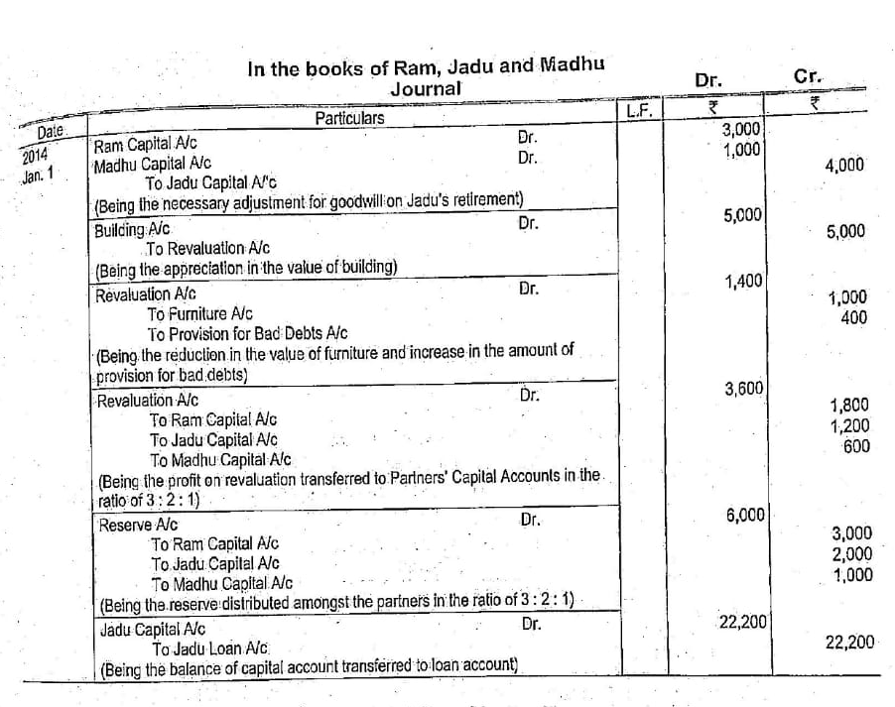
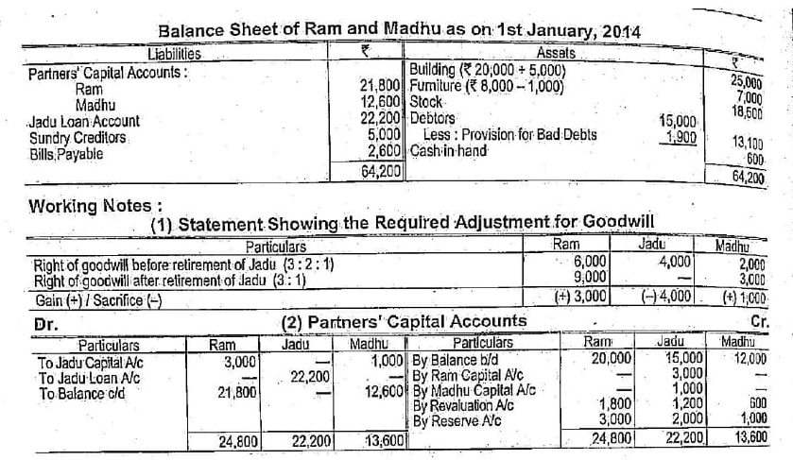
Solution Of The Problem

Slide 14
Sources from
Modern Accountancy
By M. Hanif And A. Mukherjee

Slide 15
Thank You
For Your Attention

